Slide 1
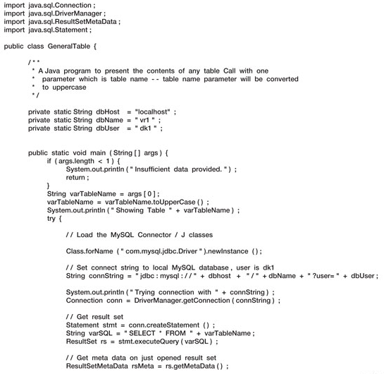
Example of JDBC Using MYSQL
Taken from Kroenke’s Book

Slide 2
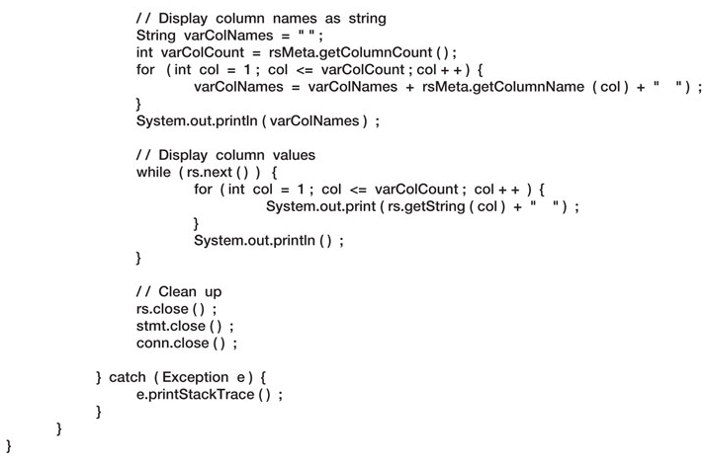
Example (contd.)

